Slide 1
MGT10009 Contemporary Management Principles
Lecture 7 The External and Internal Environments
Dr David Qian dqian@swin.edu.au
Peter Moran pmoran@swin.edu.au
Notes:
1

Slide 2
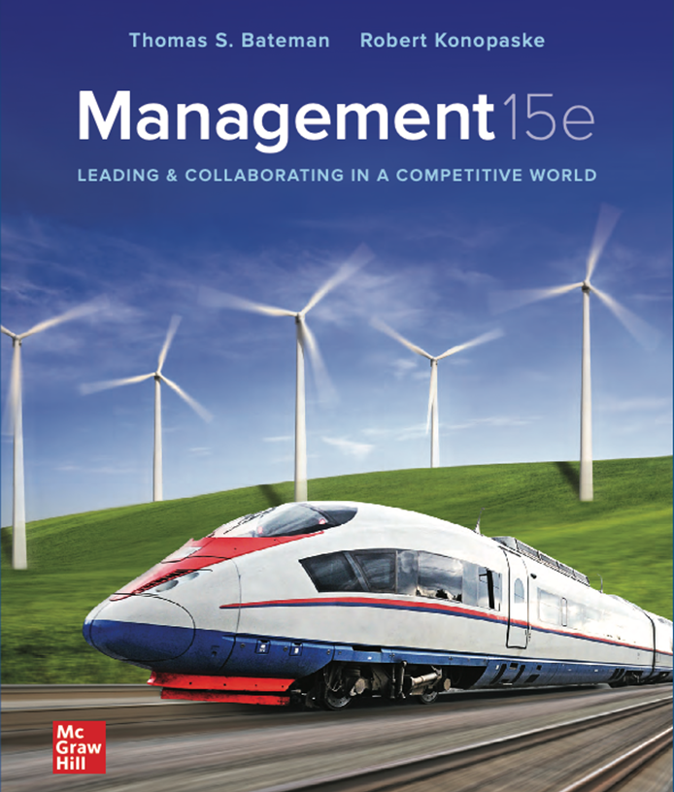
Chapter 2
The External and Internal Environments

Slide 3
Learning Objectives
Describe how environmental forces influence organizations and how organizations can influence their environments.
1
Distinguish between the macroenvironment and the competitive environment.
2
Identify elements of the competitive environment.
3
Summarize how organizations respond to environmental uncertainty.
4
Define elements of an organization’s culture.
5
Discuss how an organization’s culture and climate affect its response to its external environment.
6

Slide 4
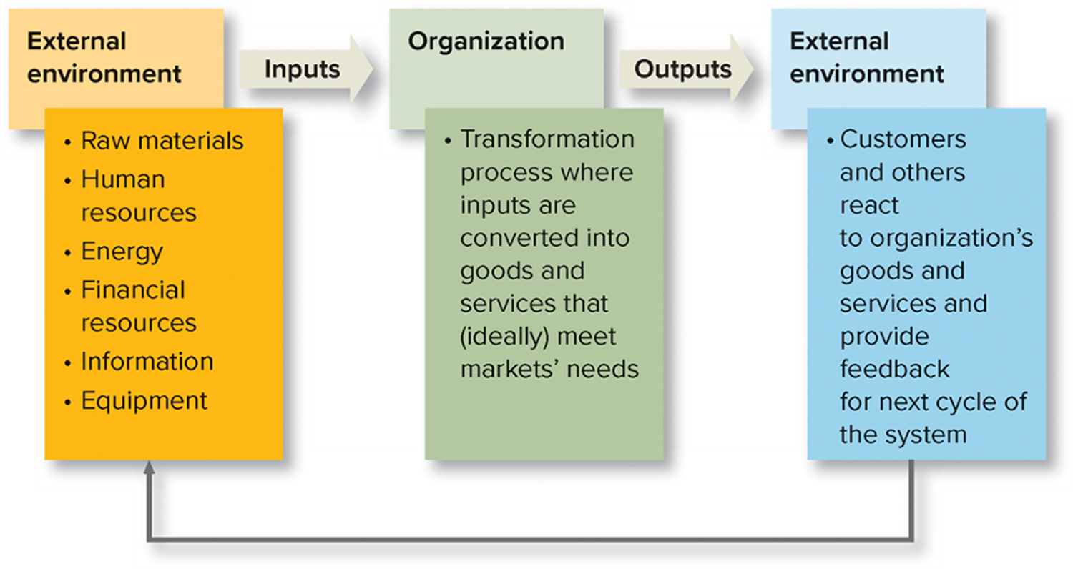
Open Systems
Exhibit 2.1 Organization as an Open System
Organizations are affected by, and affect, their environment.
Inputs: goods and services organizations take in and transform them into products.
Outputs: the products and services organizations create.
Notes:
In this chapter, we discuss in detail factors outside the organizations create the context in which managers and their companies operate – and affect their success and failure.
Organizations are open systems—that is, they are affected by and in turn affect their external environment. For example, from their environment they take in inputs such as human resources and investment capital and transform them into products that are outputs to their environment.
Organizations take inputs from the external environment and return outputs, as shown in Exhibit 2.1. But when we use the term external environment here, we mean more than an organization’s clients or customers; the external environment includes all relevant forces outside the organization’s boundaries.

Slide 5
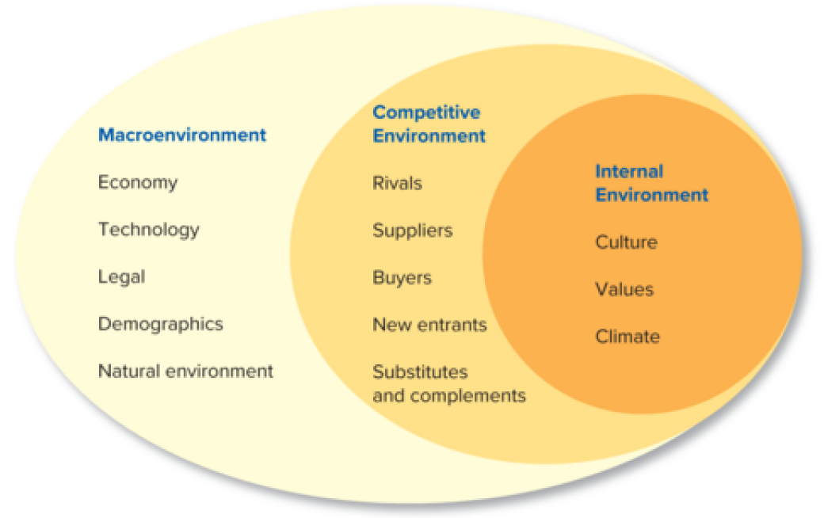
The External and Internal Environments of Organizations
External environment: All relevant forces outside a firm’s boundaries, such as competitors, customers, the government, and the economy.
Competitive environment: Includes the firm and its rivals, suppliers, buyers, new entrants, and substitute or complementary products.
Macro environment: Affects all organizations and includes economic, technological, legal and political, demographic, social, and natural environment factors.
Notes:
The organization exists in its competitive environment, which is composed of the firm and its rivals, suppliers, buyers (customers), new entrants, and substitute or complementary products. More generally, the macroenvironment affects all organizations and includes economic, technological, legal and political, demographic, social, and natural environment factors.
Exhibit 2.2 shows the external and internal environments of a business organization. The organization exists in its competitive environment, which is composed of the firm and its rivals, suppliers, customers (buyers), new entrants, and substitute or complementary products. At the most general level is the macroenvironment, which includes legal, political, economic, technological, demographic, and social and natural factors that generally affect all organizations.

Slide 6
The Economy and Managers
The economic environment affects managers’ ability to function effectively and influences their strategic choices.
Role of managers:
In publicly-held companies, managers may feel required to meet Wall Street’s earnings expectations.
Managers may focus on short-term results at the expense of long-term success.
Some managers may be tempted to engage in unethical or unlawful behavior that misleads investors.
Keep in mind that economic conditions change over time and are difficult to predict.
Notes:
The economic environment affects managers’ ability to function effectively and influences their strategic choices. Interest and inflation rates affect the availability and cost of capital, growth opportunities, prices, costs, and consumer demand for products.
Stock markets are a vital influence. In publicly held companies, managers throughout the organization feel required to meet Wall Street’s earnings expectations. Such external pressures usually have a positive effect—they help make many firms more efficient and profitable. But failure to meet those expectations can cause a company’s stock price to drop, making it more difficult for the firm to raise additional capital for investment.

Slide 7

Technology
Technological advances create new products and services, advanced production techniques, and better ways of managing and communicating.
As technology evolves, new industries, markets, and competitive niches develop.
The 3D printing process has revolutionized design.
Notes:
Today a company cannot succeed without incorporating into its strategy the astonishing technologies that continually evolve. Technological advances create new products, advanced production techniques, and better ways of managing and communicating. In addition, as technology evolves, new industries, markets, and competitive niches develop.

Slide 8
Laws and Regulations
Regulators include agencies such as:
Securities and Exchange Commission (SEC)
Occupational Safety and Health Administration (OSHA)
Equal Employment Opportunity Commission (EEOC)
National Labor Relations Board (NLRB)
Office of Federal Contract Compliance Programs (OFCCP)
Notes:
Government policies impose strategic constraints on organizations but may also provide opportunities through tax laws, economic policies, and international trade rulings.

Slide 9
Demographics
Measures of various characteristics of the people who make up groups or other social units.
Demographic trends:
Aging of the workforce.
Increasing education and skill levels.
Immigration factors.
Increasingly diverse workforce.
Notes:
Proactive managers consider workforce demographics in formulating their human resource strategies. Population changes influence the size and composition of the labor force. For example, the numbers of young workers will decline while the fastest-growing age group will be workers who are 55 and older, who are expected to represent over one-fourth of the labor force in 2026.

Slide 10
Sustainability and the Natural Environment
Organizations depend on the natural environment to provide them with resources.
Operations impact quality and quantity of resources.
Impacts on local citizens.
https://www.youtube.com/watch?v=SNag4j0nmKU
Notes:
Striking the right balance between using natural resources in a constructive rather than destructive way is an ongoing challenge for all organizations.

Slide 11
SPOTLIGHT ON . . . Combating Climate Change
Combating climate change will require efforts from individuals, governments, nonprofits, and businesses alike.
The impact of any one person, just as with one company, will be minimal. Collectively, however, positive change is possible.
What do you think the role of business should be in relation to the environment?
Do you patronize businesses, or might you choose an employer, based on their sustainability efforts? Why or why not?
Notes:
Some who worry about climate change think it’s up to politicians to enact solutions. But many businesses are taking initiative to combat this growing challenge. Conventional wisdom is shifting from seeing green initiatives as job killers to job creators. Firms are reexamining everything from their traditional supply chains to the types of energy they consume to their materials they use to make products.
Students’ responses to these questions will vary, and provide an interesting discussion.

Slide 12
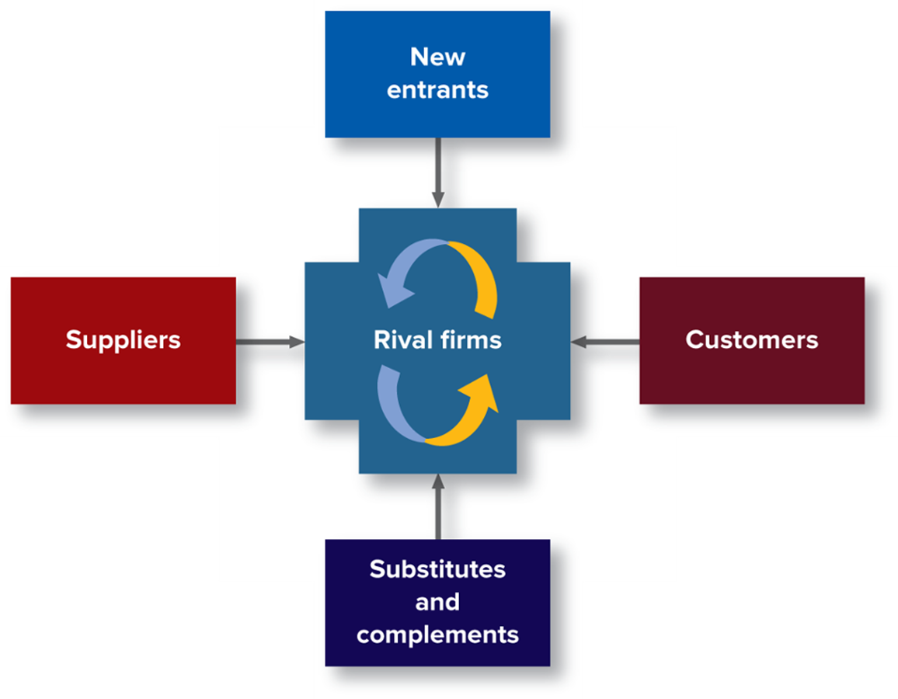
Exhibit 2.4 The Competitive Environment
Notes:
As shown in Exhibit 2.4, the competitive environment includes rivalries among current competitors and the impact of new entrants, substitute and complementary products, suppliers, and customers. This model originally was developed by Michael Porter, a Harvard professor and a noted authority on strategic management. In making strategic decisions, Porter’s model is an excellent method to help managers analyze the competitive environment and adapt to or influence the nature of their competition.

Slide 13
Competitors
Competition is most intense when:
There are many direct competitors.
Industry growth is slow.
Product/service is not easily differentiated
Notes:
Competitors within an industry must consider one another when making strategic decisions. When organizations compete for the same customers and try to win market share at the others’ expense, all must react to and anticipate their competitors’ actions.

Slide 14
New Entrants
Barriers to Entry:
Conditions that prevent new companies from entering an industry.
Government policy, capital requirements, brand identification, cost disadvantages, and distribution channels.
Notes:
Barriers sometimes prevent new companies from entering an industry. Major barriers to entry are government policy, capital requirements, brand identification, cost disadvantages, and well-established distribution channels.

Slide 15
Substitutes and Complements
Substitutes:
Alternative products or services.
Potential threat.
Complements:
Products or services that increase purchases of other products.
Potential opportunity.
Notes:
Besides products that compete directly, other products can affect a company’s performance by being substitutes for or complements of the company’s offerings. A substitute is a treat because customers can use it as an alternative, buying less of one kind of product but more of another. A complement is a potential opportunity because customers buy more of a given product if they also demand more of the complementary product.

Slide 16
Exhibit 2.5 Potential Substitutes and Complements
If the Product Is . . . | The Substitute Might Be . . .
Chipotle Burrito Bowl | Chick-fil-A meal
Apple Watch | Samsung Galaxy Watch
Ford F-150 truck | Chevy Silverado truck
Evernote | Dropbox
If the Product Is . . . | The Complement Might Be . . .
H T C Vive virtual reality headset | Eagle Flight game
Amazon streaming video | Strawberry Twizzlers
Health club membership | Workout clothes
Apartment rental | IKEA furniture
Notes:
Exhibit 2.5 lists products and their potential substitutes and complements.

Slide 17
Suppliers
Supply chain management: Managing the acquisition of materials, their transformation into products, and the distribution of products to customers.
Switching costs:
Provide resources or inputs needed for production.
Fixed costs buyers face if they change suppliers.
Notes:
Organizations are at a disadvantage if they become overly dependent on a single powerful supplier. A supplier is powerful if the buyer has few other sources of supply or if the supplier has many other buyers. Dependence also results from high switching costs—the fixed costs buyers face if they change suppliers. For example, once a buyer learns how to operate a supplier’s equipment, such as a data analytics application, the buyer faces both economic and psychological costs in changing to a new supplier.
Supply chain management is a vital contributor to a company’s competitiveness and profitability. By supply chain management, also known as the extended enterprise, we mean the managing of the entire network of facilities and people that obtain raw materials from outside the organization, transform them into products, and distribute them to customers. Supply chains should be not only cost-efficient but also flexible, so that the organization can quickly respond to changes in demand.

Slide 18
Customers
Without customers to purchase its goods or services, a company won’t survive.
Final consumer (end users)
Intermediate consumer (wholesalers and retailers)
Notes:
Like suppliers, customers are important to organizations for reasons other than the money they pay for goods and services.
Intermediate customers make more purchases than final consumers do.

Slide 19
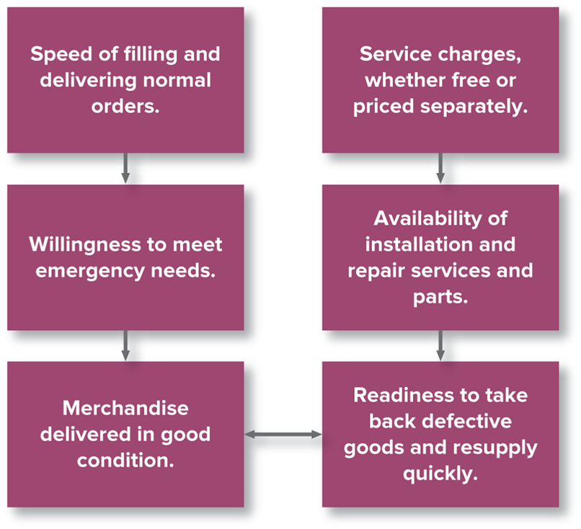
Exhibit 2.6 Actions and Attitudes Affect Customer Service
Adapted from P. Kotler, Marketing Management: Analysis, Planning, Implementation and Control, 9th ed. (Englewood Cliffs, NJ: Prentice Hall, 19 90).
Notes:
Like suppliers, customers are important to organizations for reasons other than the money they pay for goods and services. Customers can demand lower prices, higher quality, unique product specifications, or better service. They also can play competitors against one another, as occurs when a car buyer (or a purchasing agent) collects different offers and negotiates for the best price.
Exhibit 2.6 shows several actions and attitudes that contribute to excellent customer service.

Slide 20
Environmental Analysis
Environmental uncertainty: Lack of information needed to understand or predict the future.
Environmental complexity: The number of issues that must be attended to as well as the interconnectedness of these issues.
Environmental dynamism: The degree of discontinuous change that occurs within an industry.
Notes:
Information about the environment is not always readily available. In other words, managers often operate under conditions of uncertainty. Environmental uncertainty means that managers do not have enough information about the environment to understand it or predict the future. Uncertainty arises from two related factors: complexity and dynamism. Environmental complexity refers to the number of issues to which a manager must attend as well as their interconnectedness. For example, industries that have many firms that compete in vastly different ways tend to be more complex—and uncertain—than industries with only a few key competitors.
Environmental dynamism refers to the degree of discontinuous change that occurs within the industry. High-growth industries with products and technologies that change rapidly tend to be more uncertain than stable industries where changes are less dramatic and more predictable.

Slide 21
Environmental Scanning
Environmental scanning: Searching for useful information, unavailable to most, sorting that information and interpreting what is important.
Competitive intelligence: Information that helps managers determine how to compete better.
Notes:
Perhaps the first step in coping with uncertainty in the environment is identifying what might be important. Frequently, organizations and individuals act out of ignorance, only to regret those actions in the future.
Environmental scanning means both searching for useful information and interpreting what is important and what is not. Porter’s competitive analysis, discussed earlier, can guide environmental scanning and help managers evaluate the potential of different environments.

Slide 22
Exhibit 2.7 Attractive and Unattractive Environments
Environmental Factor | Unattractive | Attractive
Competitors | Many; low industry growth; equal size; commodity | Few; high industry growth; unequal size; differentiated
Threat of entry | High threat; few entry barriers | Low threat; many entry barriers
Substitutes | Many | Few
Suppliers | Few; high bargaining power | Many; low bargaining power
Customers | Few; high bargaining power | Many; low bargaining power
Notes:
Exhibit 2.7 compares the five environmental factors with columns for attractive and unattractive attributes of each.

Slide 23
Scenario Development and Forecasting
Scenario:
A narrative that describes a set of future conditions.
Best-case, worst-case.
Forecasting: Method for predicting how variables will change the future.
Notes:
As managers attempt to determine the effect of environmental forces on their organizations, they frequently develop scenarios of the future. Scenarios combine different factors into alternative combinations that offer pictures of future environments and the firm itself. Whereas environmental scanning is used to identify important factors, and scenario development is used to develop alternative pictures of the future, forecasting is used to predict exactly how variables will change in the future. For example, in making capital investments, firms may try to forecast how interest rates will change.

Slide 24
Benchmarking
The process of comparing an organization’s practices and technologies with those of other companies.
Identifying the best-in-class performance by one or more companies in a given area and comparing your processes to their processes.
Notes:
Benchmarking means identifying the best-in-class performance by one or more companies in a given area, say, product development or customer service, and then comparing your processes to theirs. To accomplish this, a benchmarking team would collect information on its own company’s operations and those of others to determine differences. These gaps serve as a point of entry to learn the underlying causes of performance differences.

Slide 25
Selecting Your Environment
Strategic maneuvering: An organization’s maneuver around potential threats and capitalize on arising opportunities.
Domain selection: Entrance to a new market or industry with an existing expertise.
Diversification: Occurs when a firm invests in a different types of businesses or products.
Mergers: Two or more companies combine with another.
Acquisitions: One firm buys another to form single a company.
Divestitures: A firm sells one or more businesses.
Prospectors: Continuously change the boundaries of their competitive environment by seeking new products and markets, diversifying and merging, or acquiring new enterprises.
Defenders: Stay within a stable product domain as a strategic manoeuvre.
Notes:
It is essential to manage the external environment effectively. Organizations need not be stuck within some given environment; they have options for defining where they operate. We refer to this as strategic maneuvering. Firms can maneuver around potential threats and capitalize on arising opportunities. Managers can use several strategic maneuvers, including domain selection, diversification, merger and acquisition, and divestiture.
A merger or acquisition takes place when two or more firms combine, or one firm buys another, to form a single company. Combining operations can create cost efficiencies and give companies relatively quick access to an entirely different industry or a specific new customer base, product, or technology. Divestiture occurs when a company sells one or more businesses.
Some companies, called defenders, stay within a limited, stable product domain. In contrast, prospectors, are more likely to engage in strategic maneuvering. Aggressive companies continuously change the boundaries of their competitive environments by seeking new products and markets, diversifying, and merging or acquiring new enterprises. In these and other ways, corporations put their competitors on the defensive and force them to react.

Slide 26
Influencing Your Environment
Independent strategies: Strategies that an organization acting on its own uses to change some aspect of its current environment.
Cooperative strategies: Strategies used by two or more organizations working together to manage the external environment.
Notes:
In addition to selecting a new environment, managers can act to change certain features of their current environment. Two general types of proactive responses are independent action and cooperative action.
A company uses independent strategies when it acts on its own to change some aspect of its current environment. Exhibit 2.8 (summarized on the next slide) shows the definitions and uses of these strategies.
In some situations, two or more organizations work together using cooperative strategies to influence the environment. Exhibit 2.9 (summarized in a subsequent slide) shows several examples of cooperative strategies.

Slide 27
Exhibit 2.8 Independent Action
Strategy | Definition
Competitive aggression | Exploiting a distinctive competence or improving internal efficiency for competitive advantage.
Competitive pacification | Taking independent action to improve relations with competitors.
Public relations | Establishing and maintaining favorable images in people’s minds.
Voluntary action | Making voluntary commitments to various interest groups, causes, and social challenges.
Legal action | Engaging a company in a private legal battle.
Political action | Making efforts to influence elected representatives to create a more favorable business environment or limit competition.
Notes:
This table recreates part of Exhibit 2.8. with definitions of six independent actions: competitive aggression, competitive pacification, public relations, voluntary action, legal action and political action.

Slide 28
Exhibit 2.9 Cooperative Action
Strategy | Definition | Strategy
Contraction | Negotiating an agreement between the organization and another group to exchange goods, services, information, patents, and so on. | Starbucks and Keurig Green Mountain enter into a contract to offer more Starbucks K-Cup pack offerings.
Cooptation | Absorbing new elements into the organization’s leadership structure to avert threats to its stability or existence. | Consumer and labor representatives are added to a large retailer’s board of directors.
Coalition | Two or more groups coalescing and acting jointly with respect to some set of issues for some period of time. | The Business Roundtable and the U.S. Chamber of Commerce lobby Congress on behalf of businesses.
Notes:
This table recreates Exhibit 2.9. with the definition of and examples of cooperative action: contraction, cooption and coalition.

Slide 29
Adapting to the Environment: Changing the Organization
To cope with environmental uncertainty and change, organizations can adjust structures and work processes.
Buffering
Smoothing
Flexible processes
Notes:
Buffering creates supplies of excess resources to meet unpredictable needs. Organizations also may try smoothing, or leveling fluctuations occurring at the environmental boundaries. Buffering and smoothing manage uncertainties at system boundaries, firms also can establish flexible processes that allow for adaptation in their technical core.

Slide 30
Choosing an Approach
Considerations in managing external environment:
Aim at elements of environment that
Cause the company problems.
Provide it with opportunities.
Allow the company to change successfully.
Choose responses that fit the environmental component of interest.
Choose actions that offer most benefit at lowest cost.
Notes:
This slides lists three considerations in managing the external environment.

Slide 31
Organization Culture
The set of important assumptions about the organization and its goals and practices that its members share.
Strong Cultures: majority of people within the organization agree on organizational goals.
Weak Cultures: different people hold different values and there is confusion about corporate goals.
Diagnosing culture: useful clues about culture
Corporate mission statements and official goals.
Important business practices.
Symbols, rites, and ceremonies.
The stories people tell.
Cultural assessments.
Managing Culture:
Manage culture actively.
Communicate with employees regularly and set the right examples.
Celebrate and reward those who exemplify desired culture.
Notes:
An organization's culture is like an individual's personality. Organization culture is a system of shared values about what is important and beliefs about how the world works. A company’s culture provides a framework that guides people’s behavior on the job. For example, the way people dress and behave, the way they interact with each other and with customers, and the work habits that managers value are usually quite different at a bank than they are at a music company, and different again at a law firm or an advertising agency.
Let’s say you want to understand a company’s culture. Perhaps you are thinking about working somewhere and you want a good fit, or maybe you are working now and want to deepen your understanding of how your employer operates and what it expects of you. How would you go about making the diagnosis? A variety of things will give you useful insights, such as mission statements, goals, symbols, ceremonies and stories.
Some say culture eats strategy for breakfast. Make sure to manage your culture actively by communicating regularly and celebrated those who exemplify the culture.

Slide 32
Culture Ground Rules at Warby Parker
Treat customers the way we’d like to be treated.
Create an environment where employees can think big, have fun, and do good.
“Get out there.”
“Green is good.”
Source: Company website, “We Have a Couple of Ground Rules at Warby Parker,” Warby Parker, www.warbyparker.com.

Slide 33
Management in Action: The Internal Culture at Amazon
In Amazon’s 2017 annual report, Bezos wrote, “Building a culture of high standards is well worth the effort, and there are many benefits. Naturally and most obviously you’re going to build better products and services for customers”
Is it possible for a company to be as successful as Amazon without having a culture of “high standards”? Why or why not?
To what degree do and can employees “self-select” their work environments? How does Bezos’s belief inform Amazon’s reported treatment of its employees?
Notes:
In Amazon’s 2017 annual report, Bezos wrote, “Building a culture of high standards is-well worth the effort, and there are many benefits. Naturally and most obviously you’re going to build better products and services for customers.” However, there is a fine line between being competitive-inside the company or with competing organizations-and being cut-throat.
Questions:
Is it possible for a company to be as successful as Amazon without having a culture of “high standards”? Why or why not?
Student answers will vary. Some may note how different approaches are better in the short-term versus the long-term.
To what degree do and can employees “self-select” their work environments? How does Bezos’s belief inform Amazon’s reported treatment of its employees?
Student answers will again vary but should note elements from the text and their research.

Slide 34
In Review
Describe how environmental forces influence organizations and how organizations can influence their environments.
1
Distinguish between the macroenvironment and the competitive environment.
2
Identify elements of the competitive environment.
3
Summarize how organizations respond to environmental uncertainty.
4
Define elements of an organization’s culture.
5
Discuss how an organization’s culture and climate affects its response to its external environment.
6
Notes:
This slide relists the chapter learning objectives and can be used to review the chapter highlights.
Chapter 3 will focus on managerial decision making.

